Slide 1

VETRON CREST
CARE-COMFORT-CONNECTION
A Holistic Problem Needing
A Holistic Response
“Behind the myth of ‘joint families’ lies India’s real eldercare crisis.”
Aditya Ag +91-9599 088253
Notes:
1

Slide 2










INDIA'S HIDDEN ELDERCARE CRISIS
Aging Population
Digital Adoption
40% growth in seniors (2021–31) vs 8% in general population
77% of urban seniors use smartphones, enabling digital health delivery
Shift to Nuclear Families
Post-COVID Mindset
60% nuclear families; children as buyers, often NRIs
Seniors & families now demand safety, medical support, and engagement
Rising Affluence
Baby boomers retiring with disposable income, lifestyle expectations
Source: Blume-Eldercare Bluprint

Slide 3






USER PERSONAS
Name | Mrs. Neha (42) | Mr. Raghavan (76) | Dr. Sharma (55)
Profile | Working Daughter in Delhi NCR HR Professional, mother of two. | Retired Banker Lives alone in Gurugram | Oncologist at Medanta Refers patients who need palliative care
Situation | Lives 15 km from her 72-yr-old father- Travels frequently for work | Recently had knee replacement Feels lonely, misses companionship | Need reliable care post-treatment Concerned about home care quality
Pain Point | Constant worry about father's safety No time to manage meds, appointments | Struggles with stairs, diet, cleaning No daily social engagement | Lack of trained palliative setups No structured referral network
What they Seek | Trustworthy, holistic care option- Safe, engaging environment | Dignified, active community Emergency medical support | Partner institution offering high-quality care Regular reporting & patient updates

Slide 4

A FULL-STACK ELDERCARE SOLUTION
STAY REQUIRED
INDEPENDENT LIVING
❌ NO STAY ❌ NO CARE
Self-sufficient seniors living at home No daily care needed
ASSISTED LIVING
✅ STAY ❌ Limited CARE
Senior-optimized stay, meals
Social engagement programs
CARE REQUIRED
Home Care Services
❌ NO STAY ✅ CARE
At-home Health care support
Medication support
COMPREHENSIVE CARE
✅ STAY ✅ CARE
Post-operative recovery
Vital monitoring

Slide 5
STAY + CARE : STRUCTURED
ELDERCARE MODEL
Aspect | Stay | Care
What Elders Face | Safety & daily living difficulties Loneliness & isolation | Medication & health monitoring Post-surgery recovery Chronic condition care
Impact on Families | Constant worry Disrupted routines | Caregiver burnout Hidden costs
Our Solution | Safe, senior-friendly living Meals, housekeeping, social activities | Tiered care plans 24/7 nursing, physio, medication support
Tech Integration | Panic buttons Family updates app | Vitals monitoring Emergency response
Pricing | ₹35K–₹90K/month | ₹15K–₹40K add-on packages
Notes:
3

Slide 6
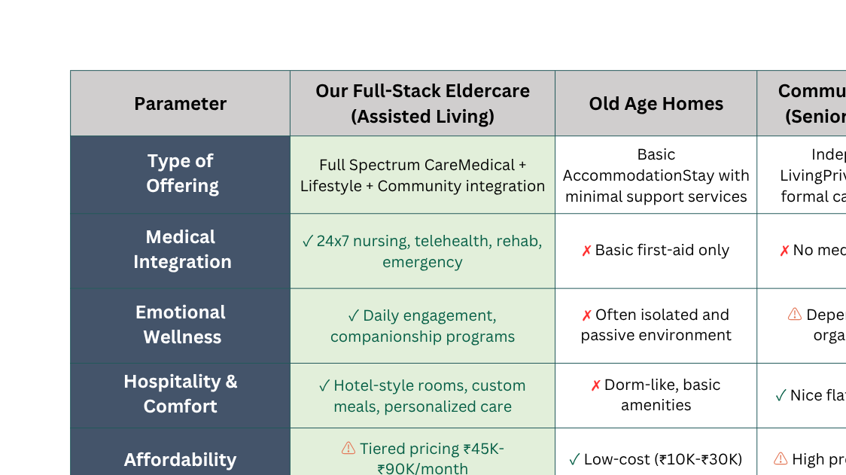
The Landscape of Eldercare in India
Comprehensive analysis of different care models and their features

Slide 7






OUR CORE DIFFERENTIATORS
Vital Tracking
Vitals monitoring, emergency alerts, family updates
Nutritional Food
Safety & Emergency
Culturally tailored, medically appropriate diets
Round-the-clock staff, secure access, panic support
Hygienic Stay
Custom Engagement
Clean, comfortable, senior-optimized rooms
Daily activities, yoga, music, games, community bonding
Care
Comfort
Connection

Slide 8



"LAYERED REVENUE STREAMS IN A FULL-STACK CARE MODEL"
Stay
Rental
Care
Services
Additional Services
Health
Services
Products
80%
60%
40%
20%
10%
Accommodations with housekeeping and meals.
Tiered medical and nursing support.
Physio, yoga, and senior outings.
Diagnostics, meds, and doctor consults.
Aids, wearables, and nutrition items.
% of residents utilizing each service layer

Slide 9








GTM: FROM CONCERN TO CONVERSION
Medical Partnerships (Phase 1)
01
Tie-ups with hospitals for referrals
Engage top geriatricians and specialists
02
Digital-First Acquisition (Phase 1)
Hyper-targeted online campaigns
Build trust via reviews & real-time updates
03
Affluent Urban Families & NRIs (Phase 2)
Outreach to senior clubs, gated communities, NRI groups
Target decision-makers (adult kids, 40–60 yrs)
04
Community & Trust-Building (Phase 2)
Run camps, wellness events, family days
Drive local referrals via testimonials
05
Corporate & CSR Alliances (Phase 3)
Partner with employers for eldercare plans
Leverage CSR/government care programs

Slide 10
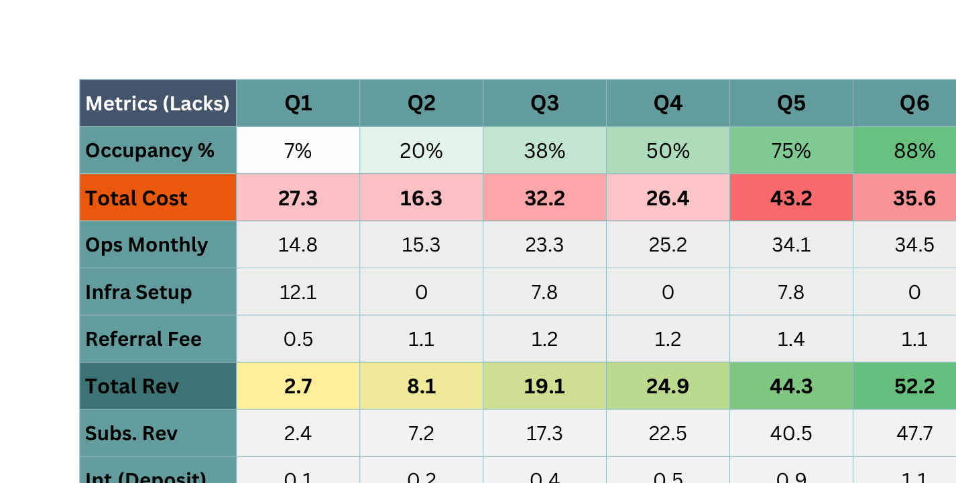
Projected Financial Performance
Unit Level Quarterly Financial Analysis & Growth Metrics (Q1-Q8)

Slide 11
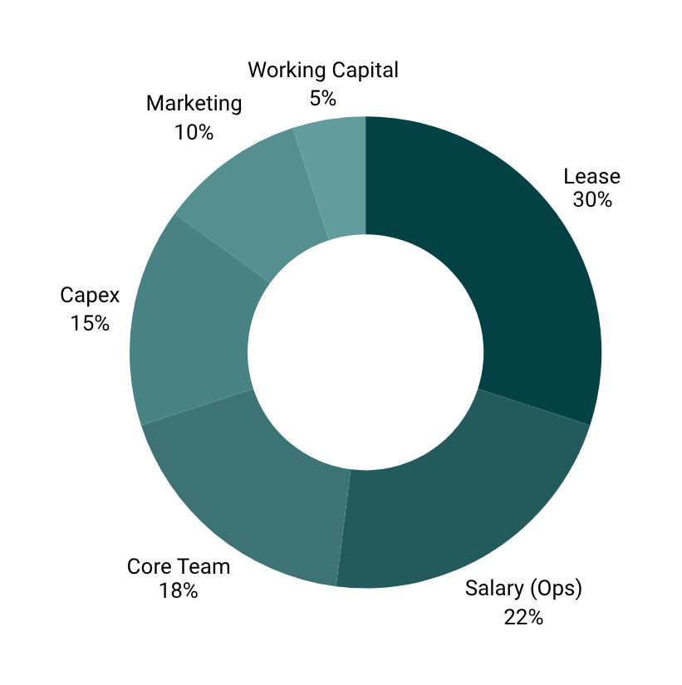
Investment Overview
Funds Required: ₹80L
Scope: Launch & Operate 1 Unit in NCR
Key Milestones
Operational
Break-even
(months)
12
Use Of funds
Breakdown
20-24
Project Payback
Period (months)
₹6L+
Monthly Profit
(from Q6)

Slide 12






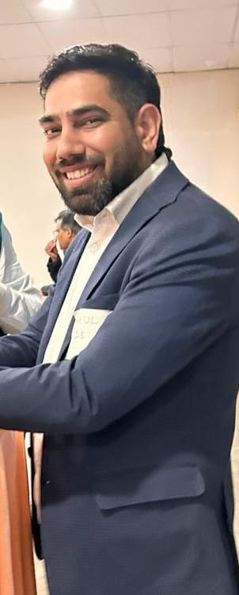
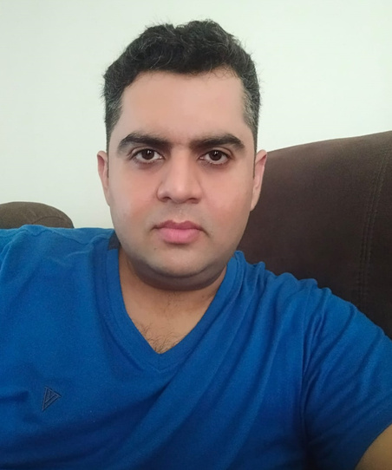


OUR CORE TEAM
Aditya Agrawal
Rahul Rode
Nitin Khatri
CEO
COO
CTO
Ex-entrepreneur with a decade of leadership in healthcare & hospitality
10+ years in sales and ops in hospitality; 5+ years of hands-on leadership in eldercare services.
Tech lead with 16+ years in digital health, building scalable, AI-driven systems.
connect@vetroncrest.com

